Slide 1
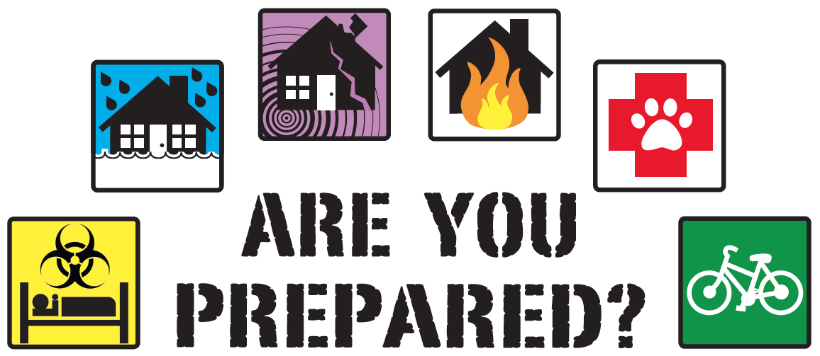
Emergency preparedness

Slide 2
What is emergency preparedness?
Preparing the agency and patients for an emergency situation specific to each region of service.
Customized plan for the agency on how to operate during an emergency.
Customized plan for the patient on how to receive care and stay safe during an emergency.

Slide 3
WHY?
CMS is requiring home health to play an active role in making sure our patients are prepared for an emergency.
The agency will be responsible for completing and updating an emergency preparedness plan for every patient.
  This plan will be customized to the patient and contain contact numbers and instructions on how to stay safe.
  This plan will be updated in any situation where the patients needs change.

Slide 4
What are the office responsibilities?
The office will keep a printed list of all patients, that shows their priority level and electricity dependent status.
The office will utilize the pyramid phone communication plan to make sure all staff are accounted for during an emergency.
The office Incident command team will lead the emergency to make sure all actions are taken and safety is maintained for staff and patients.

Slide 5
What is the clinicians responsibility?
The clinician must make sure the patient has a copy of the emergency preparedness form and knows where to find it in their home.
The clinician must discuss the plan with the patient/ caregiver and keep them updated on how to be safe during an emergency.
The clinician must refer to the plan in an emergency situation and be sure to see their priority 1 and electricity dependent patients.

Slide 6

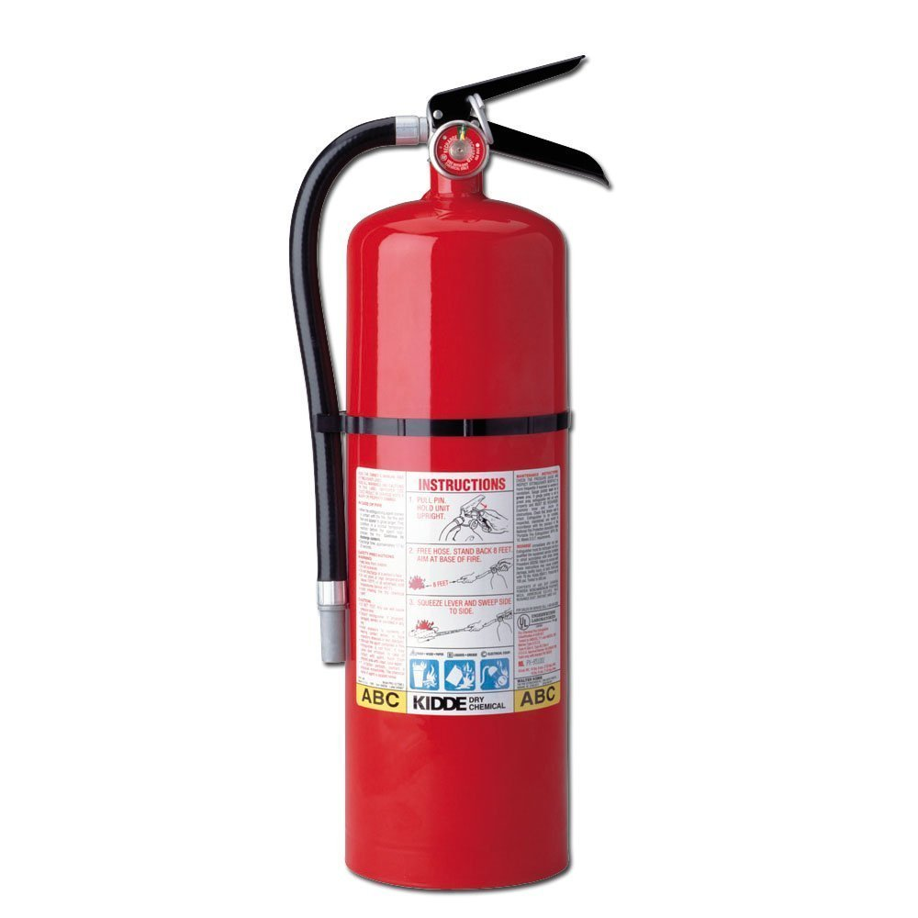

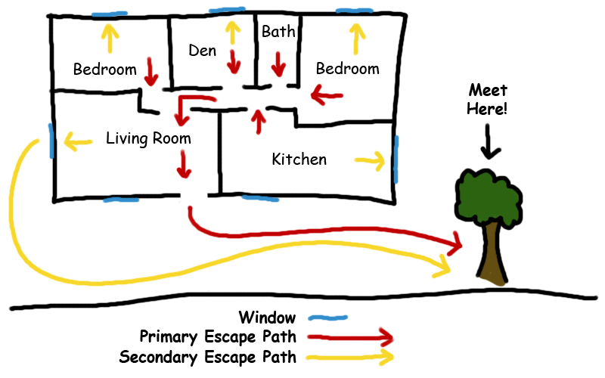
Keep this in mind…
Where are your patients flash lights?
Where are your patients fire extinguishers?
Does your patient have a basement? Where is it?
Where are all the external exits?
What's your patients exit plan in the event of an emergency?

Slide 7



A quick recap…
The office
THE clinician
The patient
Will keep a list of current patients.
Will utilize the phone tree to make sure all staff are accounted for.
Will deploy incident command to make sure all actions are taken and safety is maintained.
Will discuss the patient emergency plan with the patient and caregiver.
Will make sure the patient emergency plan is customized and accurate.
Will verify all information is correct on the emergency preparedness plan.
Will understand the emergency plan and know how to utilize it during an emergency.
Will always have an updated paper copy of the emergency plan in the home.

Slide 8
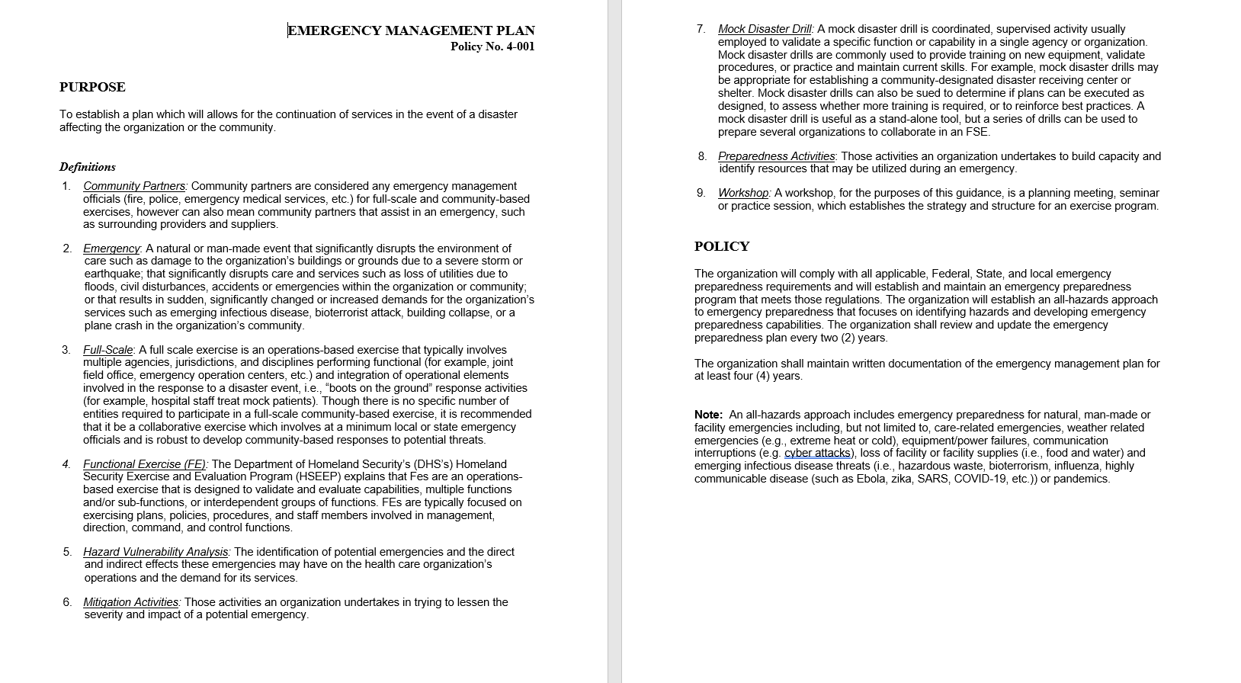

Slide 9
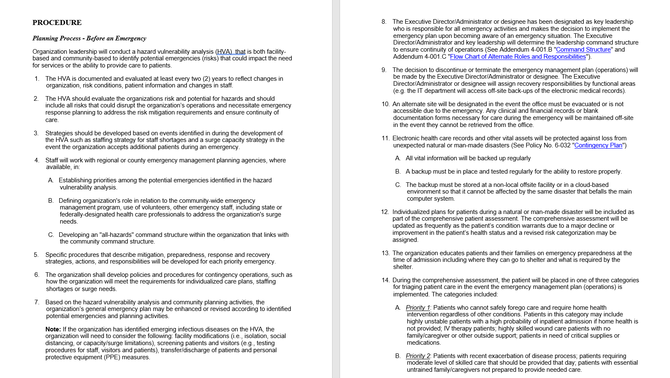

Slide 10
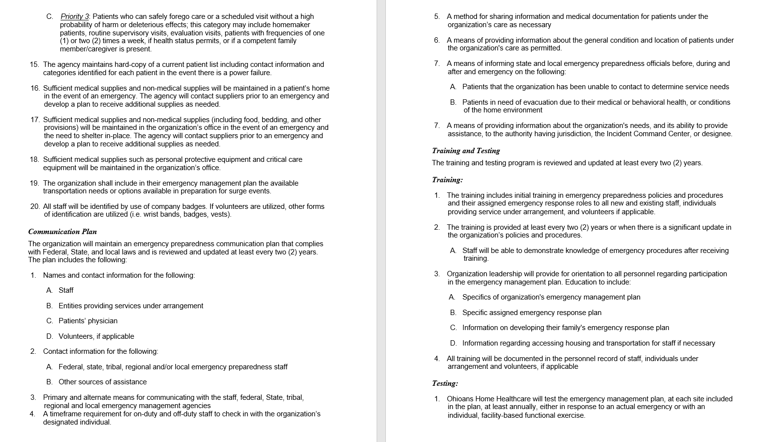

Slide 11


Slide 12
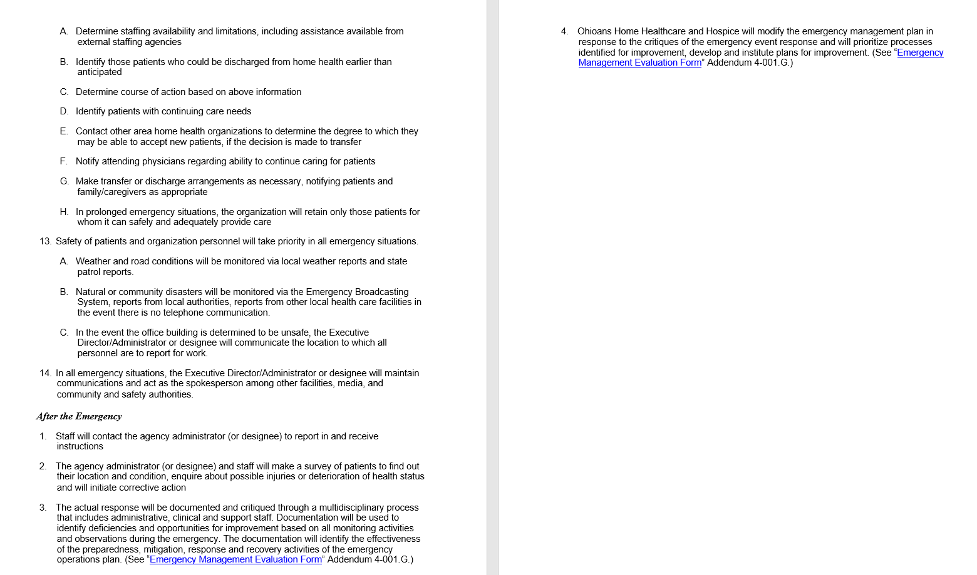

Slide 13
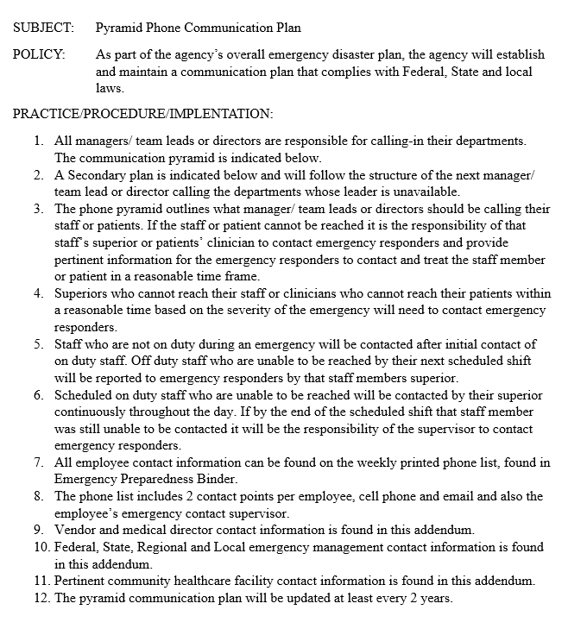

Slide 14
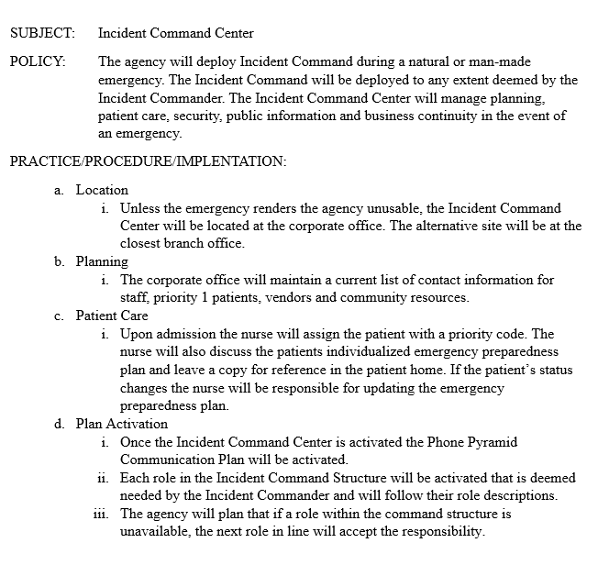
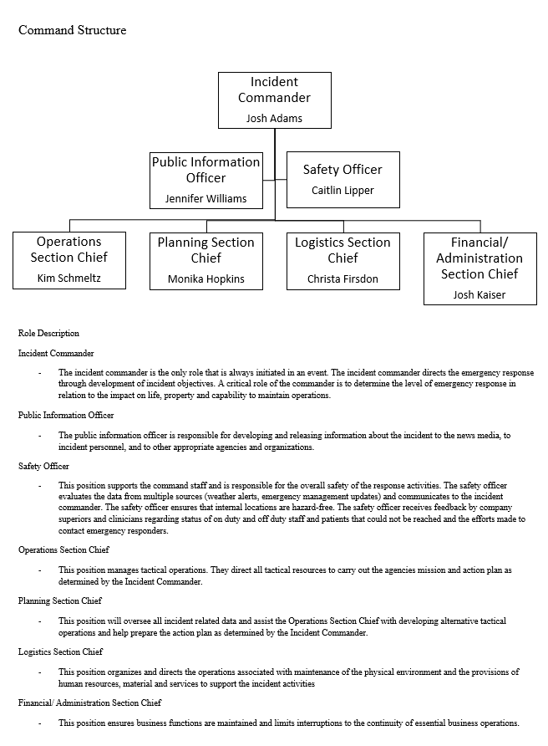

Slide 15
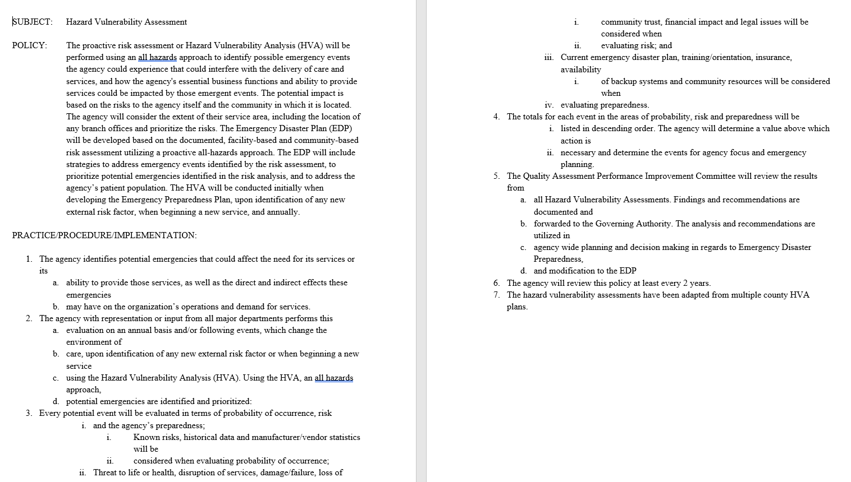

Slide 16
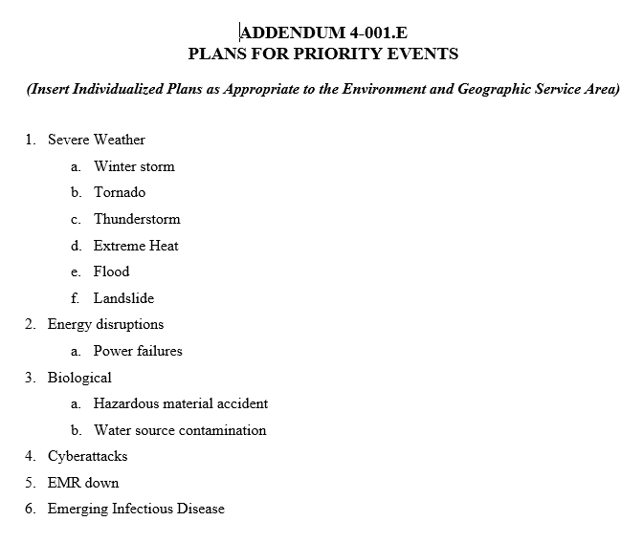

Slide 17
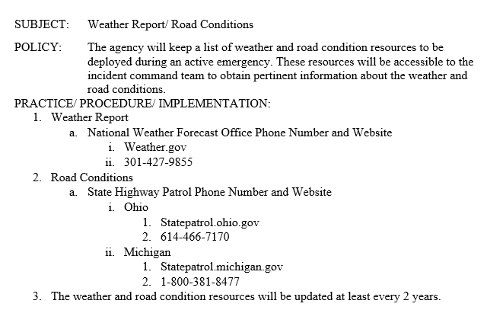

Slide 18


